Slide 1
Basic sql-part 4
Aggreagate and null value to scalar sub-query

Slide 2
Null Values and Aggregates
Total all salaries
select sum (salary ) from instructor
Above statement ignores null amounts
All aggregate operations except count(*) ignore tuples with null values on the aggregated attributes
What if collection has only null values?
count returns 0
all other aggregates return null
Notes:
2
COUNT(*) returns the number of rows in a specified table without getting rid of duplicates. It counts each row separately. This includes rows that contain null values.

Slide 3
SELECT 2 + NULL + 2 + 2 + 2 + 5 + 5 + 2 + 5
This SELECT statement will return NULL, since NULL plus anything
always returns NULL.
If we use the SUM() function on
the table, however, we can rest assured that NULLs are eliminated.
Result=25

Slide 4
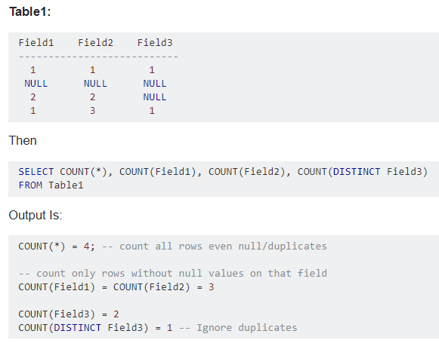

Slide 5
Nested Subqueries
SQL provides a mechanism for the nesting of subqueries.
A subquery is a select-from-where expression that is nested within another query.
A common use of subqueries is to perform tests for
set membership,
set comparisons,
set cardinality.
Notes:
5
Give example for each Set operations

Slide 6
Set membership
SQL allows testing tuples for membership in a relation. The in connective tests for set membership, where the set is a collection of values produced by a select clause.
The not in connective tests for the absence of set membership.
“Find all the courses taught in the both the Fall 2009 and Spring 2010 semesters.
Question hint “ by checking for membership…..”

Slide 7
Set Membership (Operates: in, not in)
Find courses offered in Fall 2009 and in Spring 2010
select distinct course_id
from section
where semester = ’Fall’ and year= 2009 and course_id in (select course_id
from section
where semester = ’Spring’ and year= 2010);
Find courses offered in Fall 2009 but not in Spring 2010
select distinct course_id
from section
where semester = ’Fall’ and year= 2009 and course_id not in (select course_id
from section
where semester = ’Spring’ and year= 2010);
Notes:
7
Get the teacher list who taught the course which are held in Fall 2009.
Get the list of teachers who taught in Fall 2009.
Get the subject list which has at least one pre-requist of DBS subject as a pre-requist.
Ans: Select cours_id from prerequist where prereqistId in (select prerequistId from Preriqiust where courseId=‘DBS’)

Slide 8
Example Query
Find the total number of (distinct) students who have taken course sections taught by the instructor with ID 10101
select count (distinct ID)
from takes
where (course_id, sec_id, semester, year) in (select course_id, sec_id, semester, year
from teaches
where teaches.ID= 10101);
Notes:
8
Q1: Get the course id list which are taught at least once in 2009.
Ans: select c_id from course where c_id in (select section )
List the student’s name whose advisor is from CSE department

Slide 9
The in and not in operators can also be used on enumerated sets. The following query selects the names of instructors whose names are neither “Mozart” nor “Einstein”.
select distinct name
from instructor where name not in (’Mozart’, ’Einstein’);

Slide 10
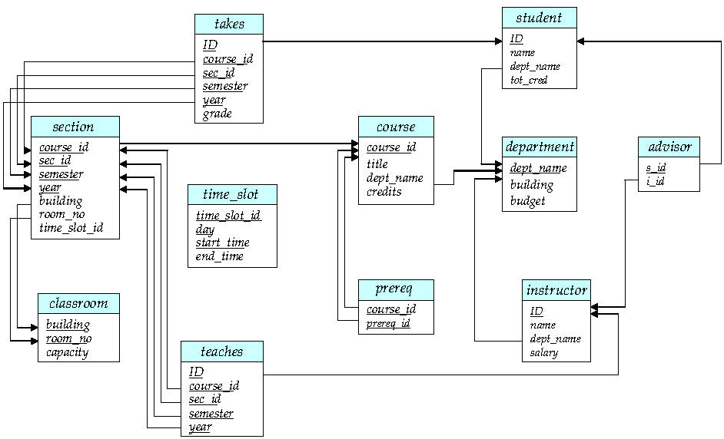

Slide 11
Set Comparison (operators: some, all)
Find names of instructors with salary greater than that of some (at least one) instructor in the Biology department.
select distinct T.name
from instructor as T, instructor as S
where T.salary > S.salary and S.dept_name = ’Biology’;
Same query using > some clause
select name
from instructor
where salary > some (select salary
from instructor
where dept_name = ’Biology’);
Notes:
11

Slide 12
The > some comparison in the where clause of the outer select is true if the salary value of the tuple is greater than at least one member of the set of all salary values for instructors in Biology.
SQL also allows < some, <= some, >= some, = some, and <> some comparison
= some is identical to in,
whereas <> some is not the same as not in

Slide 13
Definition of Some Clause
F <comp> some r ⇔ ∃ t ∈ r such that (F <comp> t ) Where <comp> can be: <, ≤, >, =, ≠
0
(5 < some
5
) = true
(read: 5 < some tuple in the relation)
6
0
(5 < some
5
) = false
0
(5 = some
) = true
5
0
(5 ≠ some
5
) = true (since 0 ≠ 5)
(= some) ≡ in
However, (≠ some) ≡ not in
Notes:
13

Slide 14
Example Query
Find the names of all instructors whose salary is greater than the salary of all instructors in the Biology department.
select name
from instructor
where salary > all (select salary
from instructor
where dept_name = ’Biology’);
As it does for some, SQL also allows < all, <= all, >= all, = all, and <> all
comparisons.
As an exercise, verify that <> all is identical to not in, whereas = all is not the same as in.
Notes:
14
Get the list of department whoes total number of courses are more than total number of courses from each of CSE & ICT & ICE / CSE or Ict or ICE department
Ans:
Select dept_name , count(*) from Course group by dept_name having count(*) > (select count(*) from course group by dept_name having dept_name = CSE & ICT & ICE )
OR
Select dept_name from course group by dept_name having count(*) > select count(*) from corse where dept=‘CSE’ and count(*) > select count(*) from course where dept=‘ICE’ and count(*) > select count(*) from corse where dept=‘ICE’ : When OR use SOME , for AND use ALL
“Find the departments that have the highest average salary.
select dept name from instructor
group by dept name having avg (salary) >= all (select avg (salary)
from instructor group by dept name);

Slide 15
Definition of all Clause
F <comp> all r ⇔ ∀ t ∈ r (F <comp> t)
0
(5 < all
5
) = false
6
6
(5 < all
) = true
10
4
(5 = all
) = false
5
4
(5 ≠ all
) = true (since 5 ≠ 4 and 5 ≠ 6)
6
(≠ all) ≡ not in
However, (= all) ≡ in
Notes:
15

Slide 16
Test for Empty Relations/ set cardinality
The exists construct returns the value true if the argument subquery is nonempty.
exists r ⇔ r ≠ Ø
not exists r ⇔ r = Ø
Ex: Get the list of courses which do not have pre-requisite courses.
Using SET operation
Select course_id from Course except select cours_id from Prereq
Using Nested Query : NOT exists
Select course_id from Cousre s where not exists (select pre_id from Prereq P where P.course_id=S.course_id)
Notes:
16
Get the list of courses which do not have pre-requisite courses.
Select course_id from Course MINUS select Course_id from Prereqist ;
OR
Select C.Course_id from Course where NOT EXISTS (select prerequist_id from Prereqist where Prereqist.Course_id = C.course_id )

Slide 17
Correlation Variables
Yet another way of specifying the query “Find all courses taught in both the Fall 2009 semester and in the Spring 2010 semester”
select course_id from section as S where semester = ’Fall’ and year= 2009 and exists (select * from section as T where semester = ’Spring’ and year= 2010 and S.course_id= T.course_id);
Correlated subquery
Correlation name or correlation variable

Slide 18
The above query also illustrates a feature of SQL where a correlation name from an outer query (S in the above query), can be used in a subquery in the where clause.
What is correlated subquery?
A subquery that uses a correlation name from an outer query is
called a correlated subquery
In queries that contain subqueries, a scoping rule applies for correlation
names. In a subquery, according to the rule, it is legal to use only correlation names defined in the subquery itself or in any query that contains the subquery.
If a correlation name is defined both locally in a subquery and globally in a containing query, the local definition applies

Slide 19
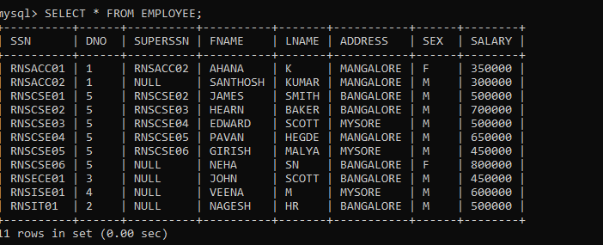

Slide 20
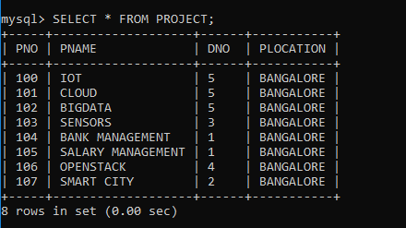

Slide 21


Slide 22
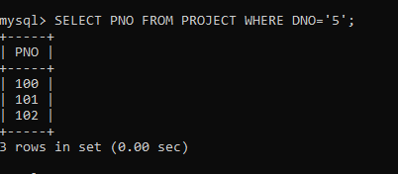

Slide 23
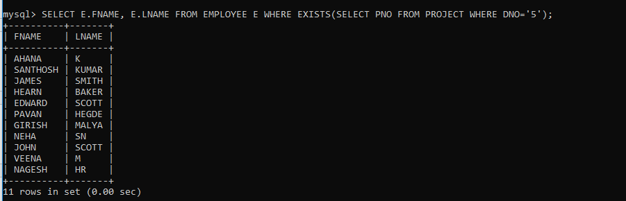

Slide 24
Not Exists
We can test for the nonexistence of tuples in a subquery by using the not exists
construct
Notes:
24
First perform , ( all bio course – all courses taken by the student ) , if it is null that means he has taken all bio courses.
Note: Cannot write this query using = all and its variants

Slide 25
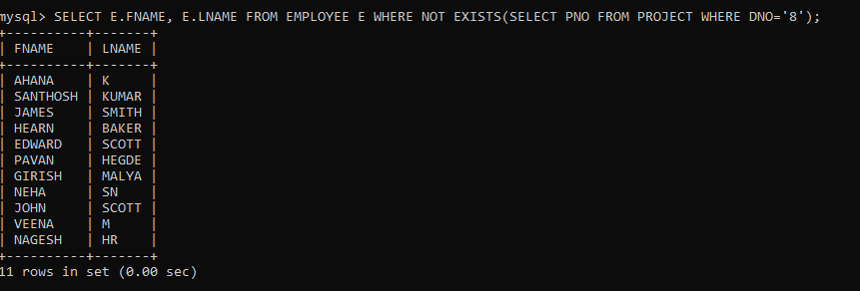

Slide 27
Find the students who have taken all courses offered in the Biology department.
select distinct S.ID, S.name
from student as S
where not exists ( (select course_id
from course
where dept_name = ’Biology’)
except
(select T.course_id
from takes as T
where T.ID = S.ID));

Slide 28
(select course_id from course
where dept_name = ’Biology’)
BIO101
BIO102
select T.course_id from takes as T
where T.ID = S.ID));
CS101
CS102
BIO101
EXCEPT: BIO102( there is a biology course not taken by student)

Slide 29
Test for Absence of Duplicate Tuples
The unique construct tests whether a subquery has any duplicate tuples in its result.
(Evaluates to “true” on an empty set)
Find all courses that were offered at most once in 2009
select T.course_id from course as T where unique (select R.course_id from section as R where T.course_id= R.course_id and R.year = 2009);
Q1: Get the students list who have taken at most one subject.
Notes:
29
Ans: for (each student) check unique (row in Takes relation )
Select Student_id from Student S where UNIQUE (Select Student_id from takes T where T.student_id =S.Student_id )
For each student unique (get student _ id from takes table for the student in outer query)

Slide 31
Subqueries in the From Clause
SQL allows a subquery expression to be used in the from clause
Find the average instructors’ salaries of those departments where the average salary is greater than $42,000.
select dept_name, avg_salary from (select dept_name, avg (salary) as avg_salary from instructor group by dept_name) where avg_salary > 42000;
Note that we do not need to use the having clause
Notes:
31

Slide 32
Subqueries in the From Clause (Cont.)
To display instructor, his salary along with his department’s average salary.
And yet another way to write it: lateral clause
select name, salary, avg_salary from instructor I1, lateral (select avg(salary) as avg_salary from instructor I2 where I2.dept_name= I1.dept_name);
Lateral clause permits later part of the from clause (after the lateral keyword) to access correlation variables from the earlier part.
Note: lateral is part of the SQL standard, but is not supported on many database systems; some databases such as SQL Server offer alternative syntax
Notes:
Q: To display instructor, his salary along with his department’s average salary.
32

Slide 33
With Clause
The with clause provides a way of defining a temporary view/relation/table whose definition is available only to the query in which the with clause occurs.
Find all departments with the maximum budget with max_budget (value) as (select max(budget) from department) select budget from department, max_budget where department.budget = max_budget.value;
Notes:
33

Slide 34
Complex Queries using With Clause
With clause is very useful for writing complex queries
Supported by most database systems, with minor syntax variations
Find all departments where the total salary is greater than the average of the total salary at all departments
with dept _total (dept_name, value) as
(select dept_name, sum(salary)
from instructor
group by dept_name),
dept_total_avg(value) as
(select avg(value)
from dept_total)
select dept_name
from dept_total, dept_total_avg
where dept_total.value >= dept_total_avg.value;
o/p: dept_total
Cs 50000
IT 60000
EC 70000
o/p: dept_total_avg
60000
o/p: EC department
Notes:
34
The with clause provides a way of defining a temporary relation whose definition is available only to the query in which the with clause occurs.

Slide 35
Scalar Subquery
Scalar subquery is one which is used where a single value is expected
List out the number of instructors in each department.
E.g.
select dept_name, (select count(*) from instructor where instructor.dept_name = D.dept_name ) as num_instructors
from department D;
Runtime error if subquery returns more than one result tuple
Notes:
List the instructors whose ten times salary must be greater than his department budget.
E.g. select name from instructor where salary * 10 > (select budget from department where department.dept_name = instructor.dept_name)
35
The scalar query is executed once for each tuple in a department.

